Slide 1
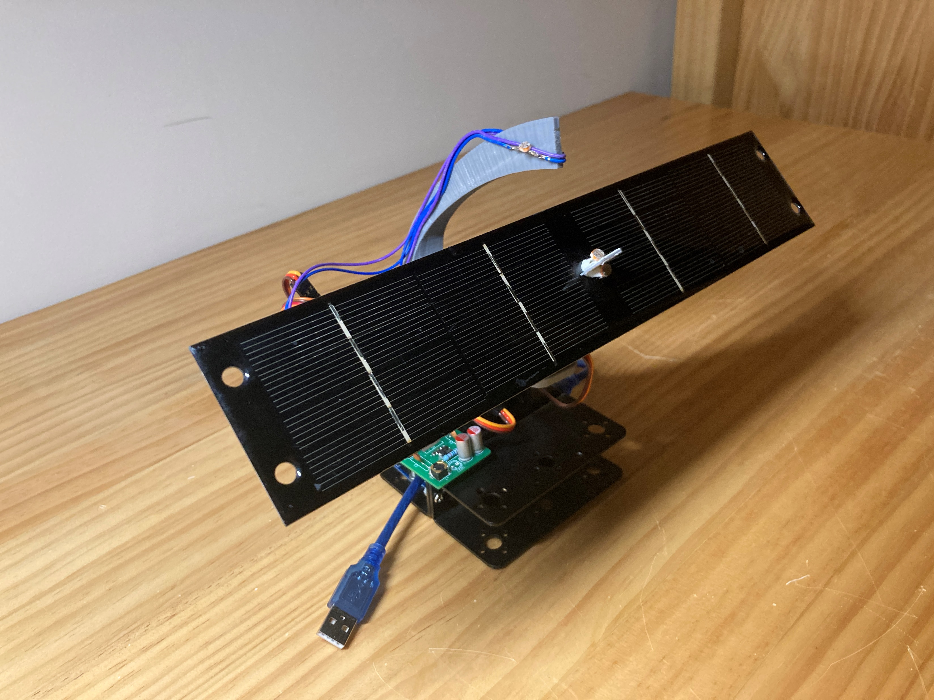
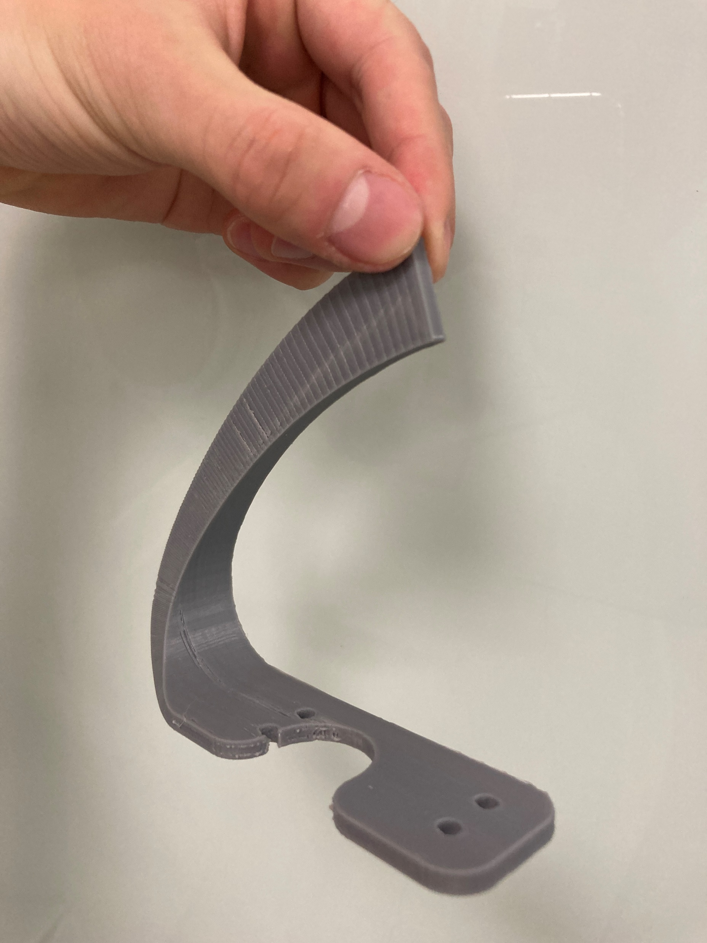
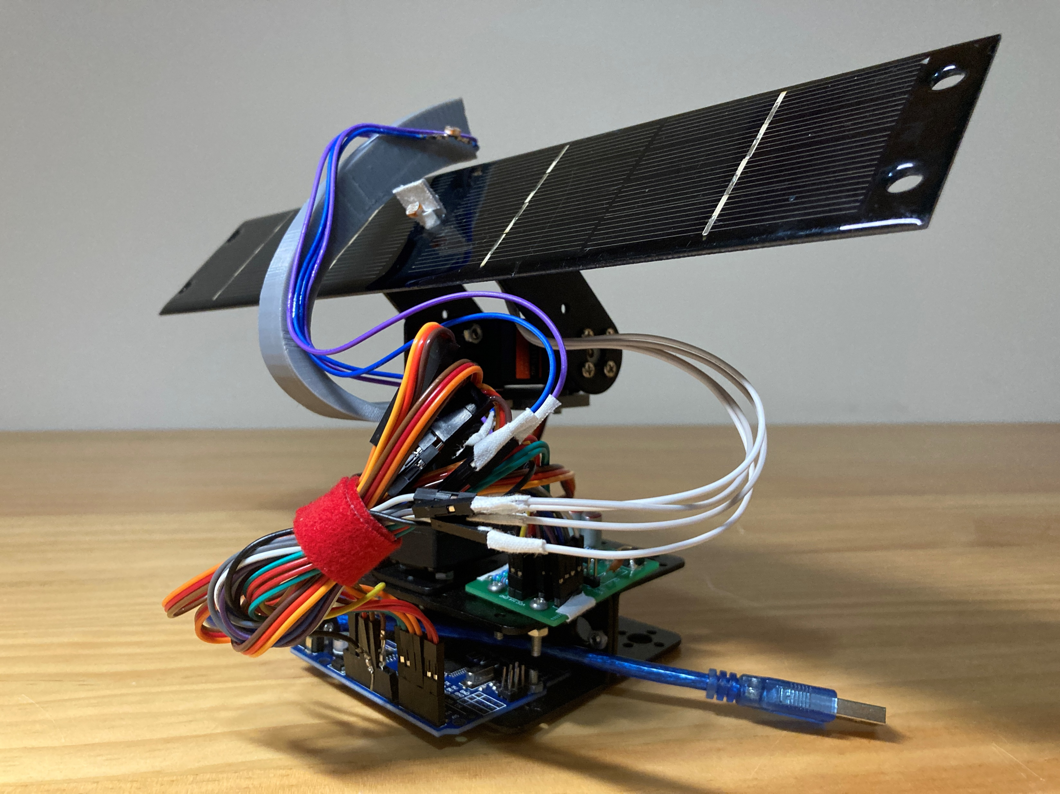
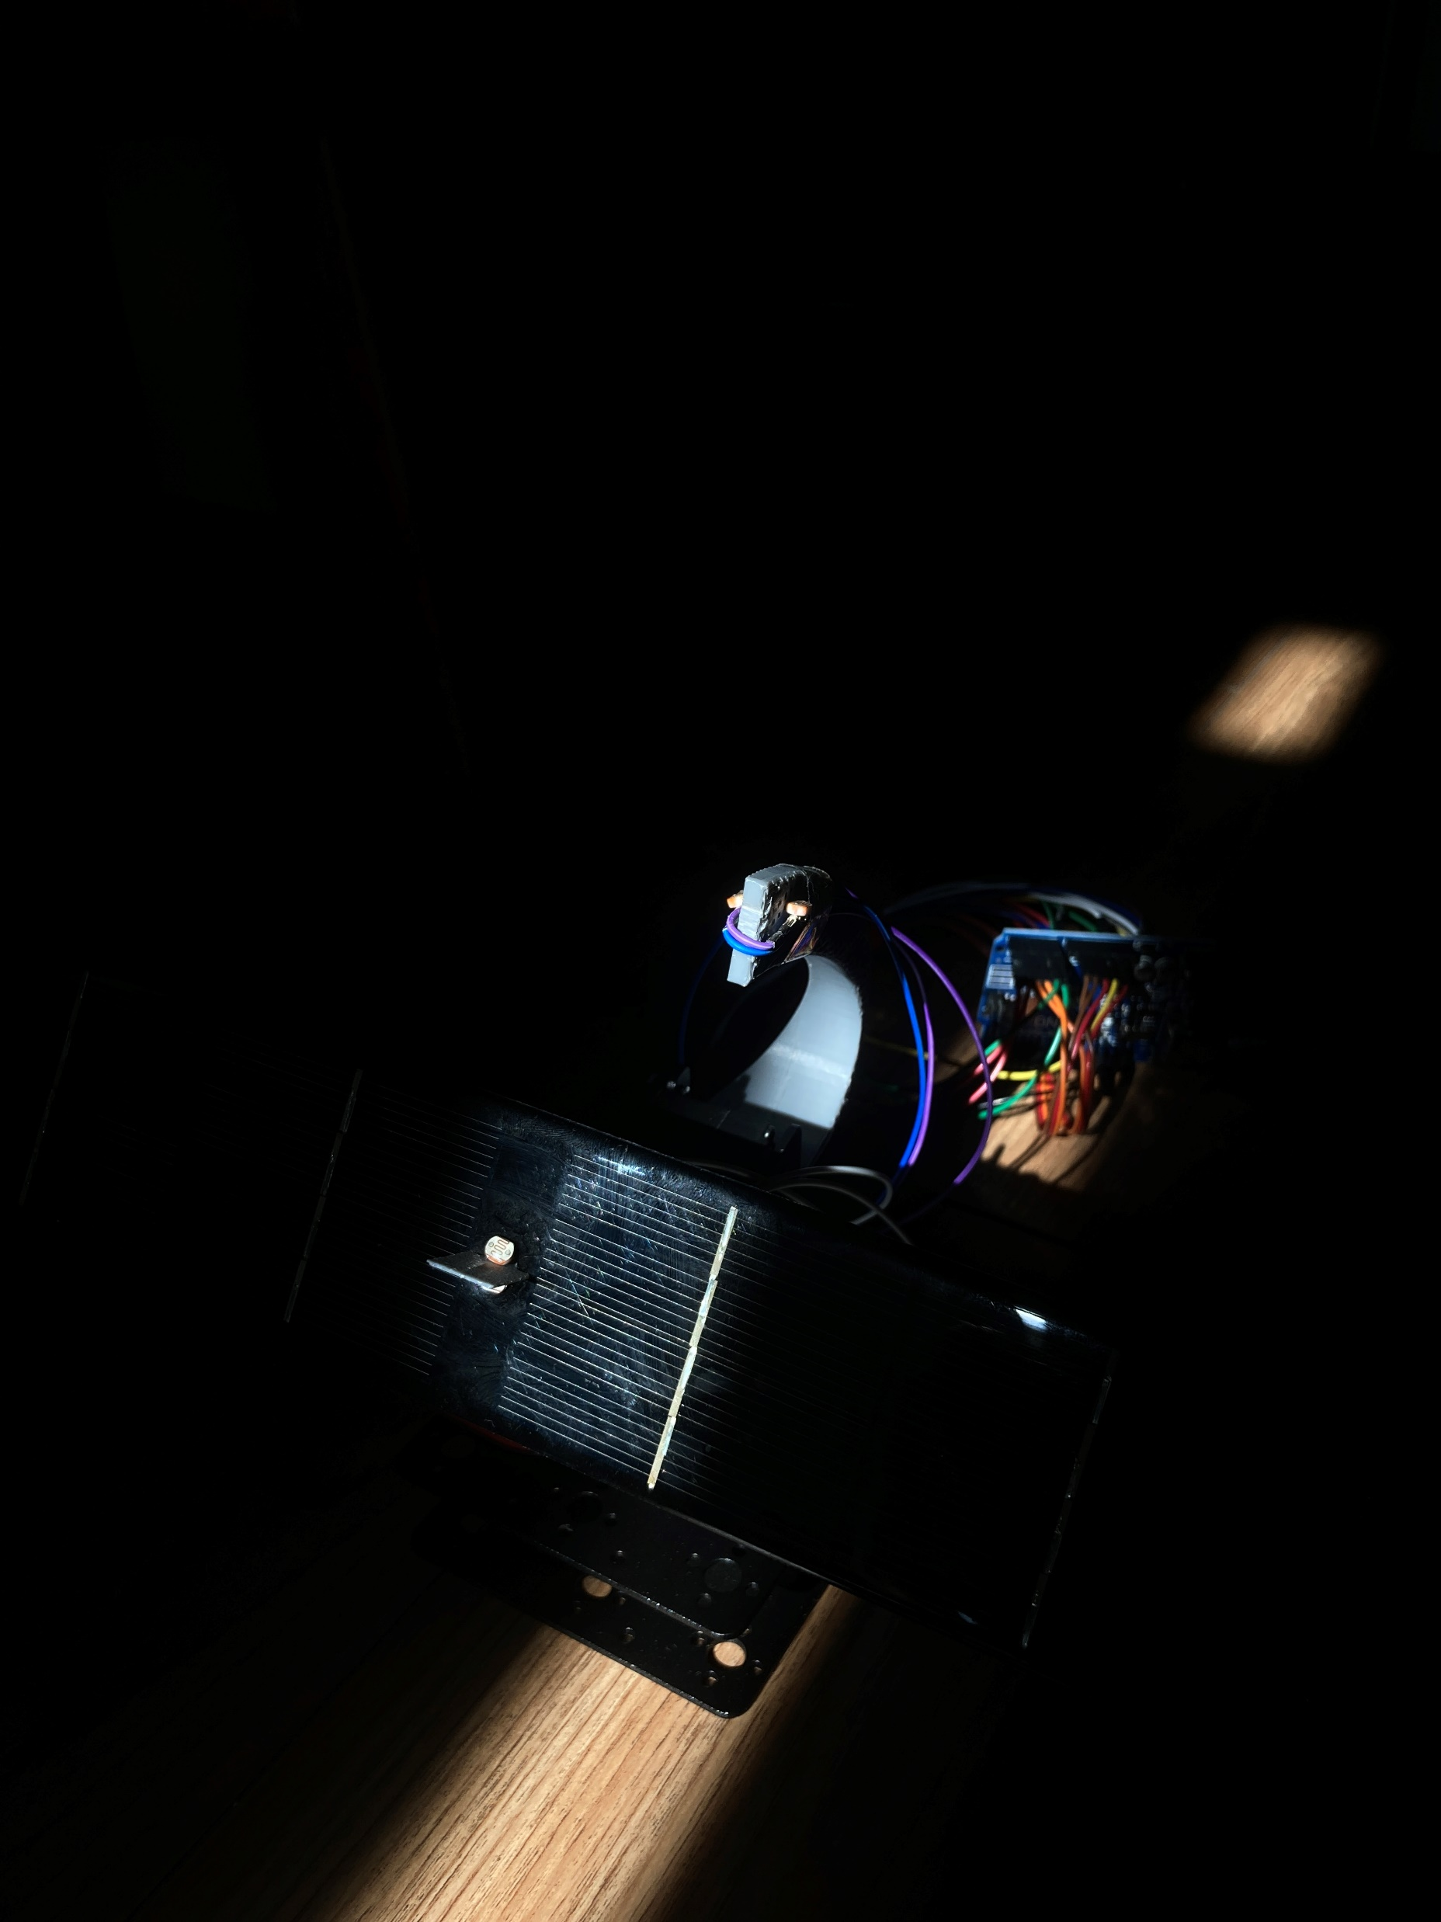

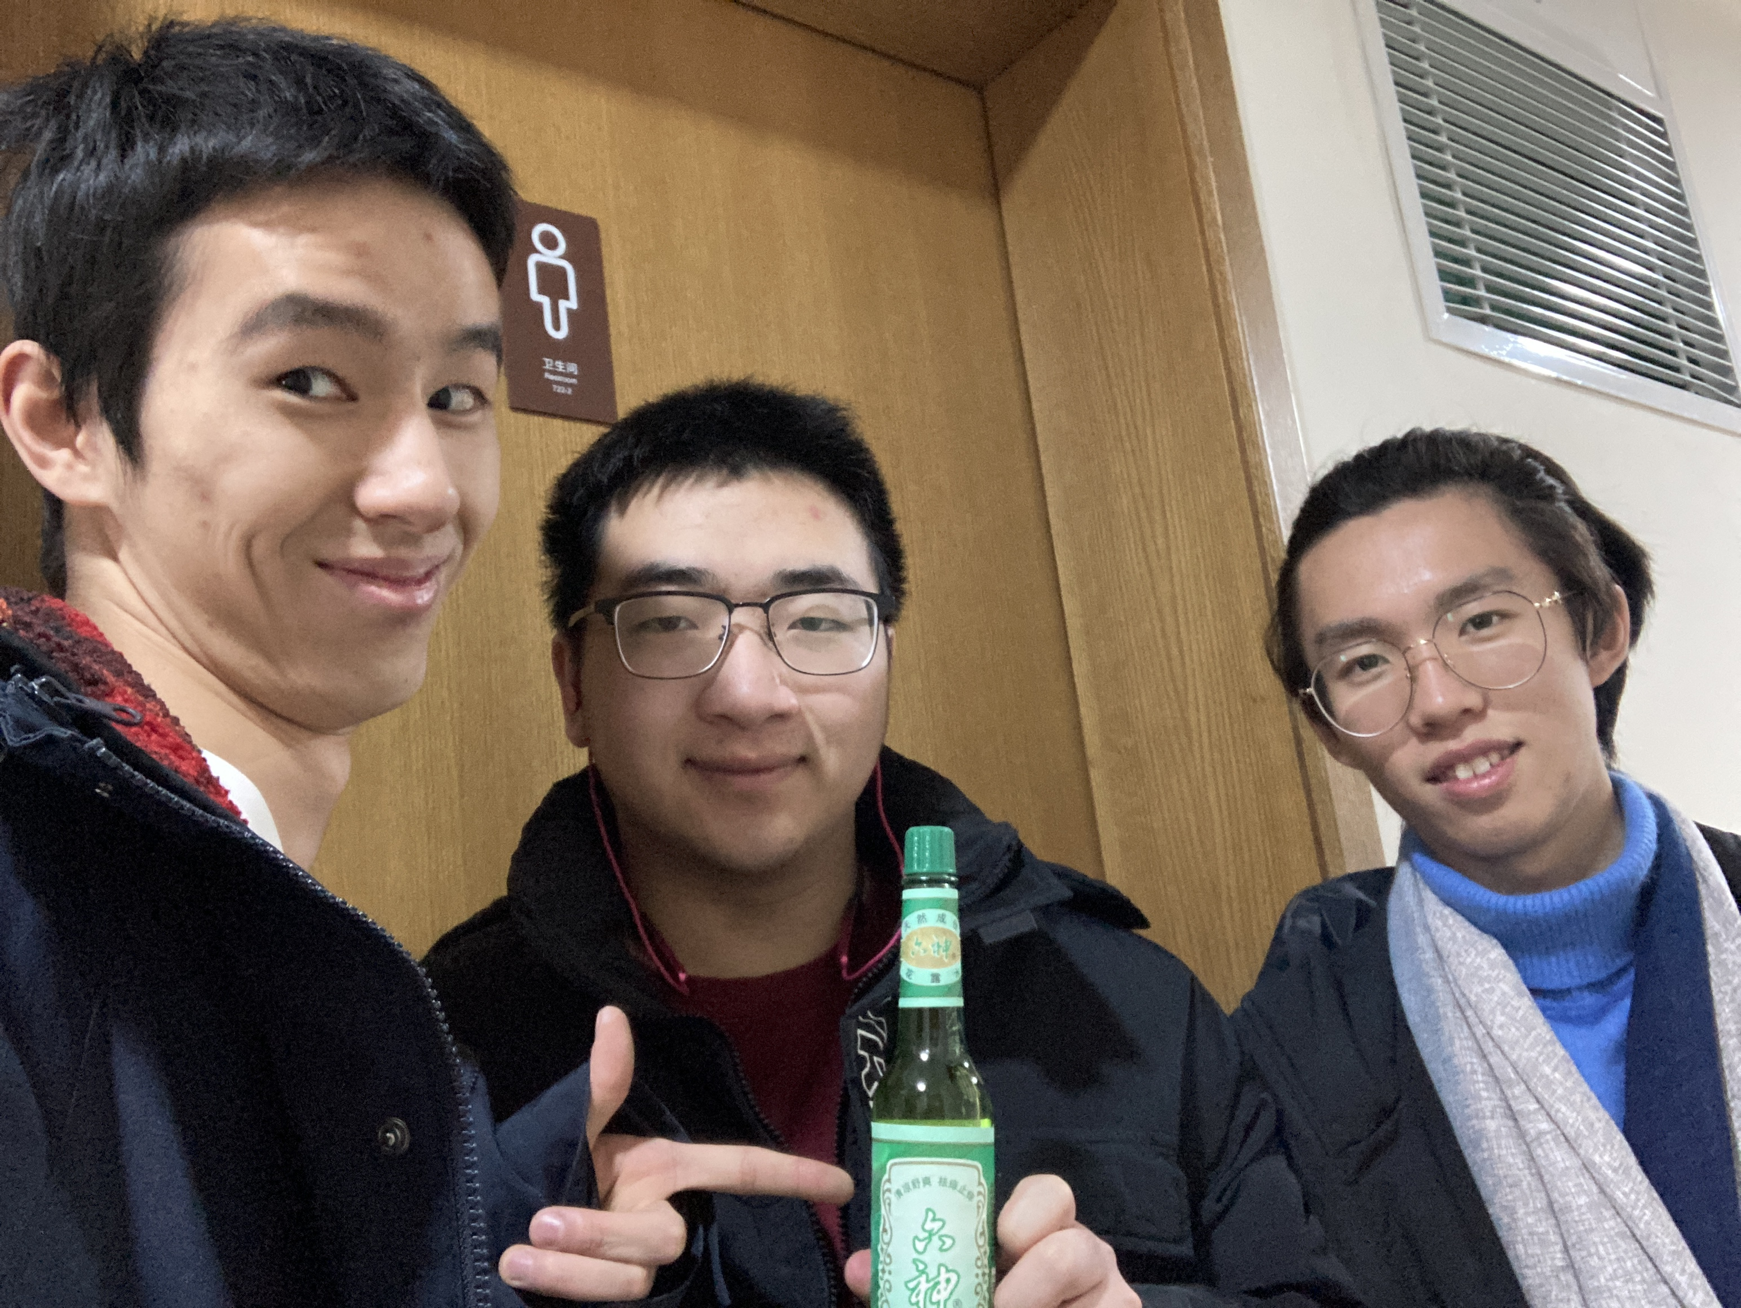
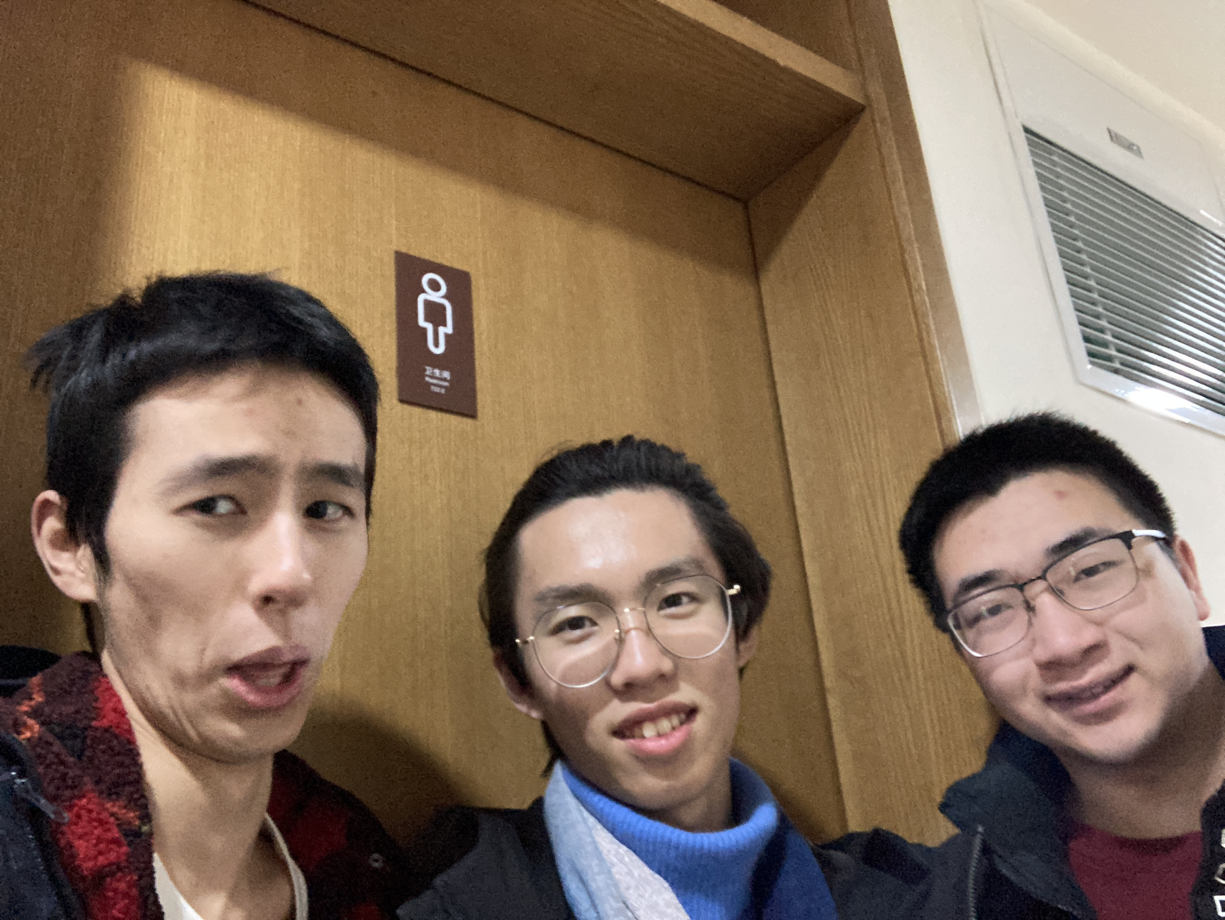

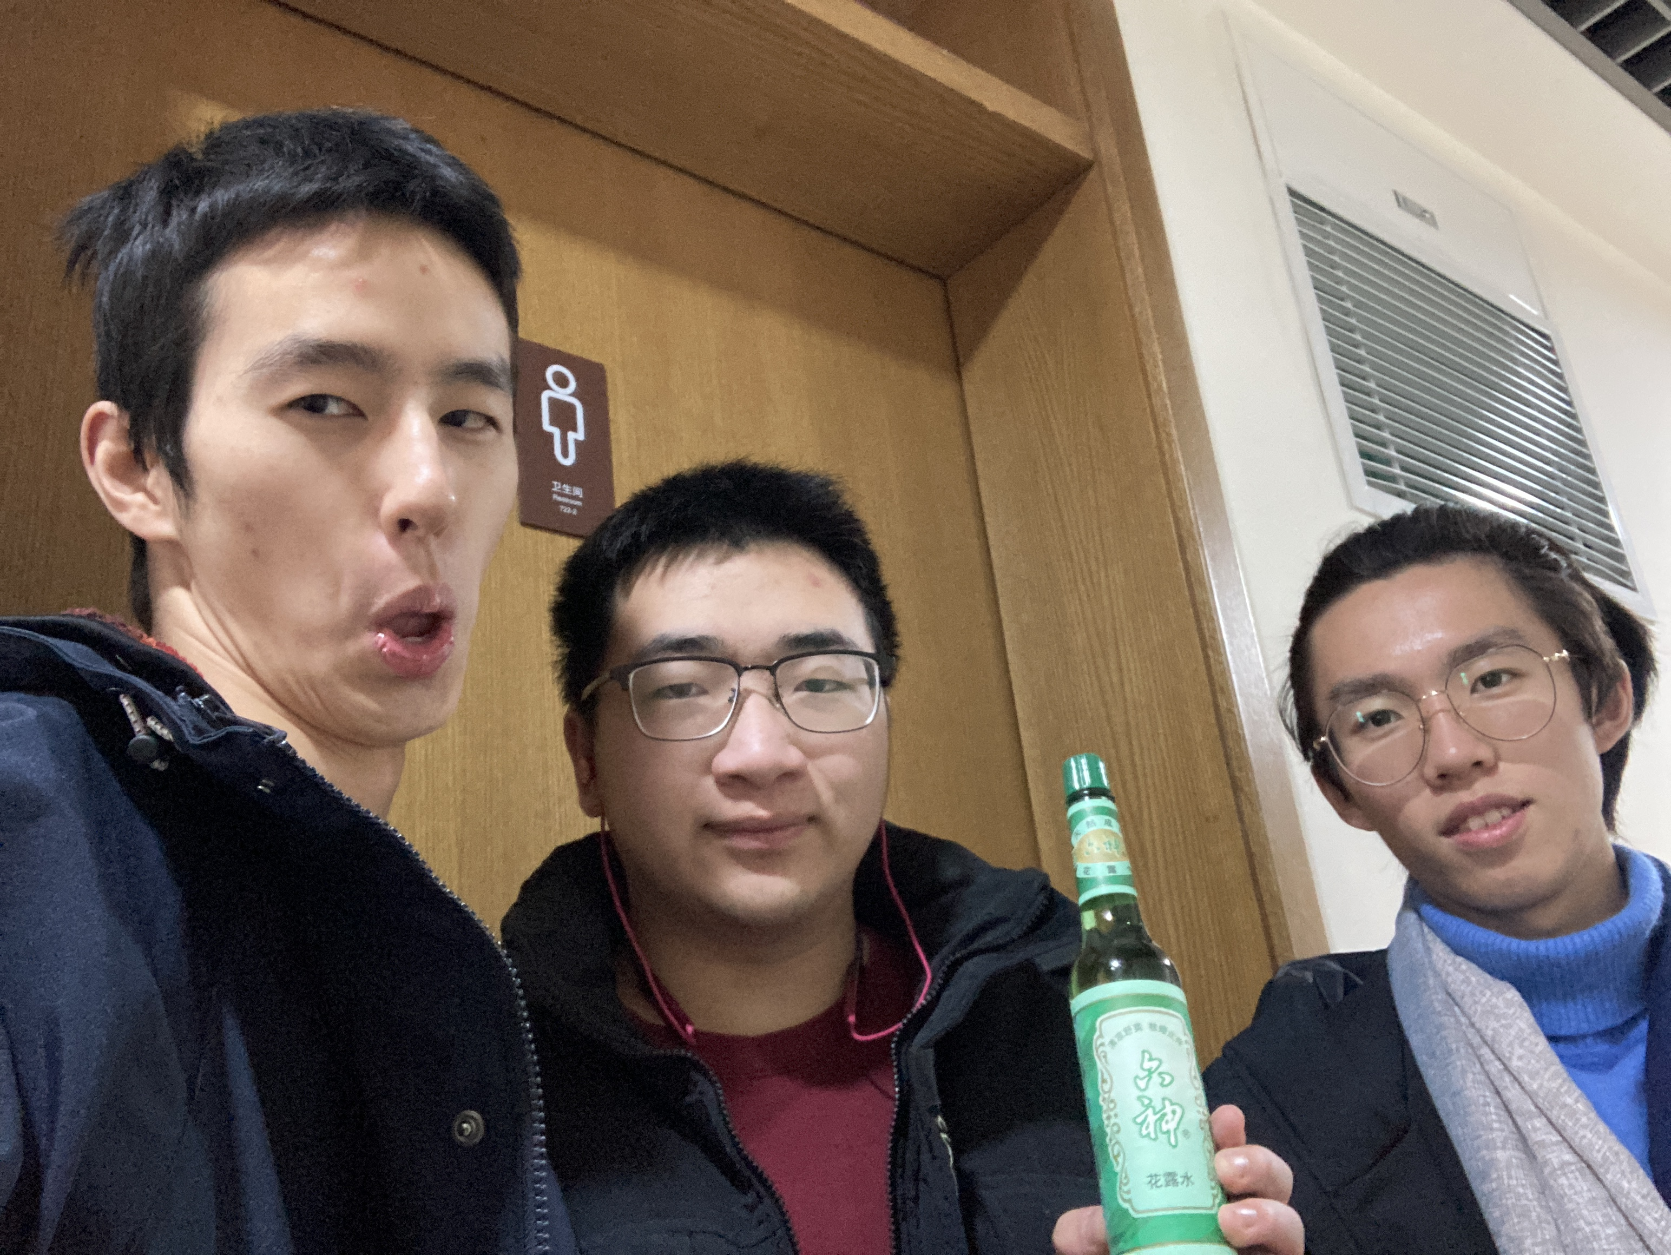

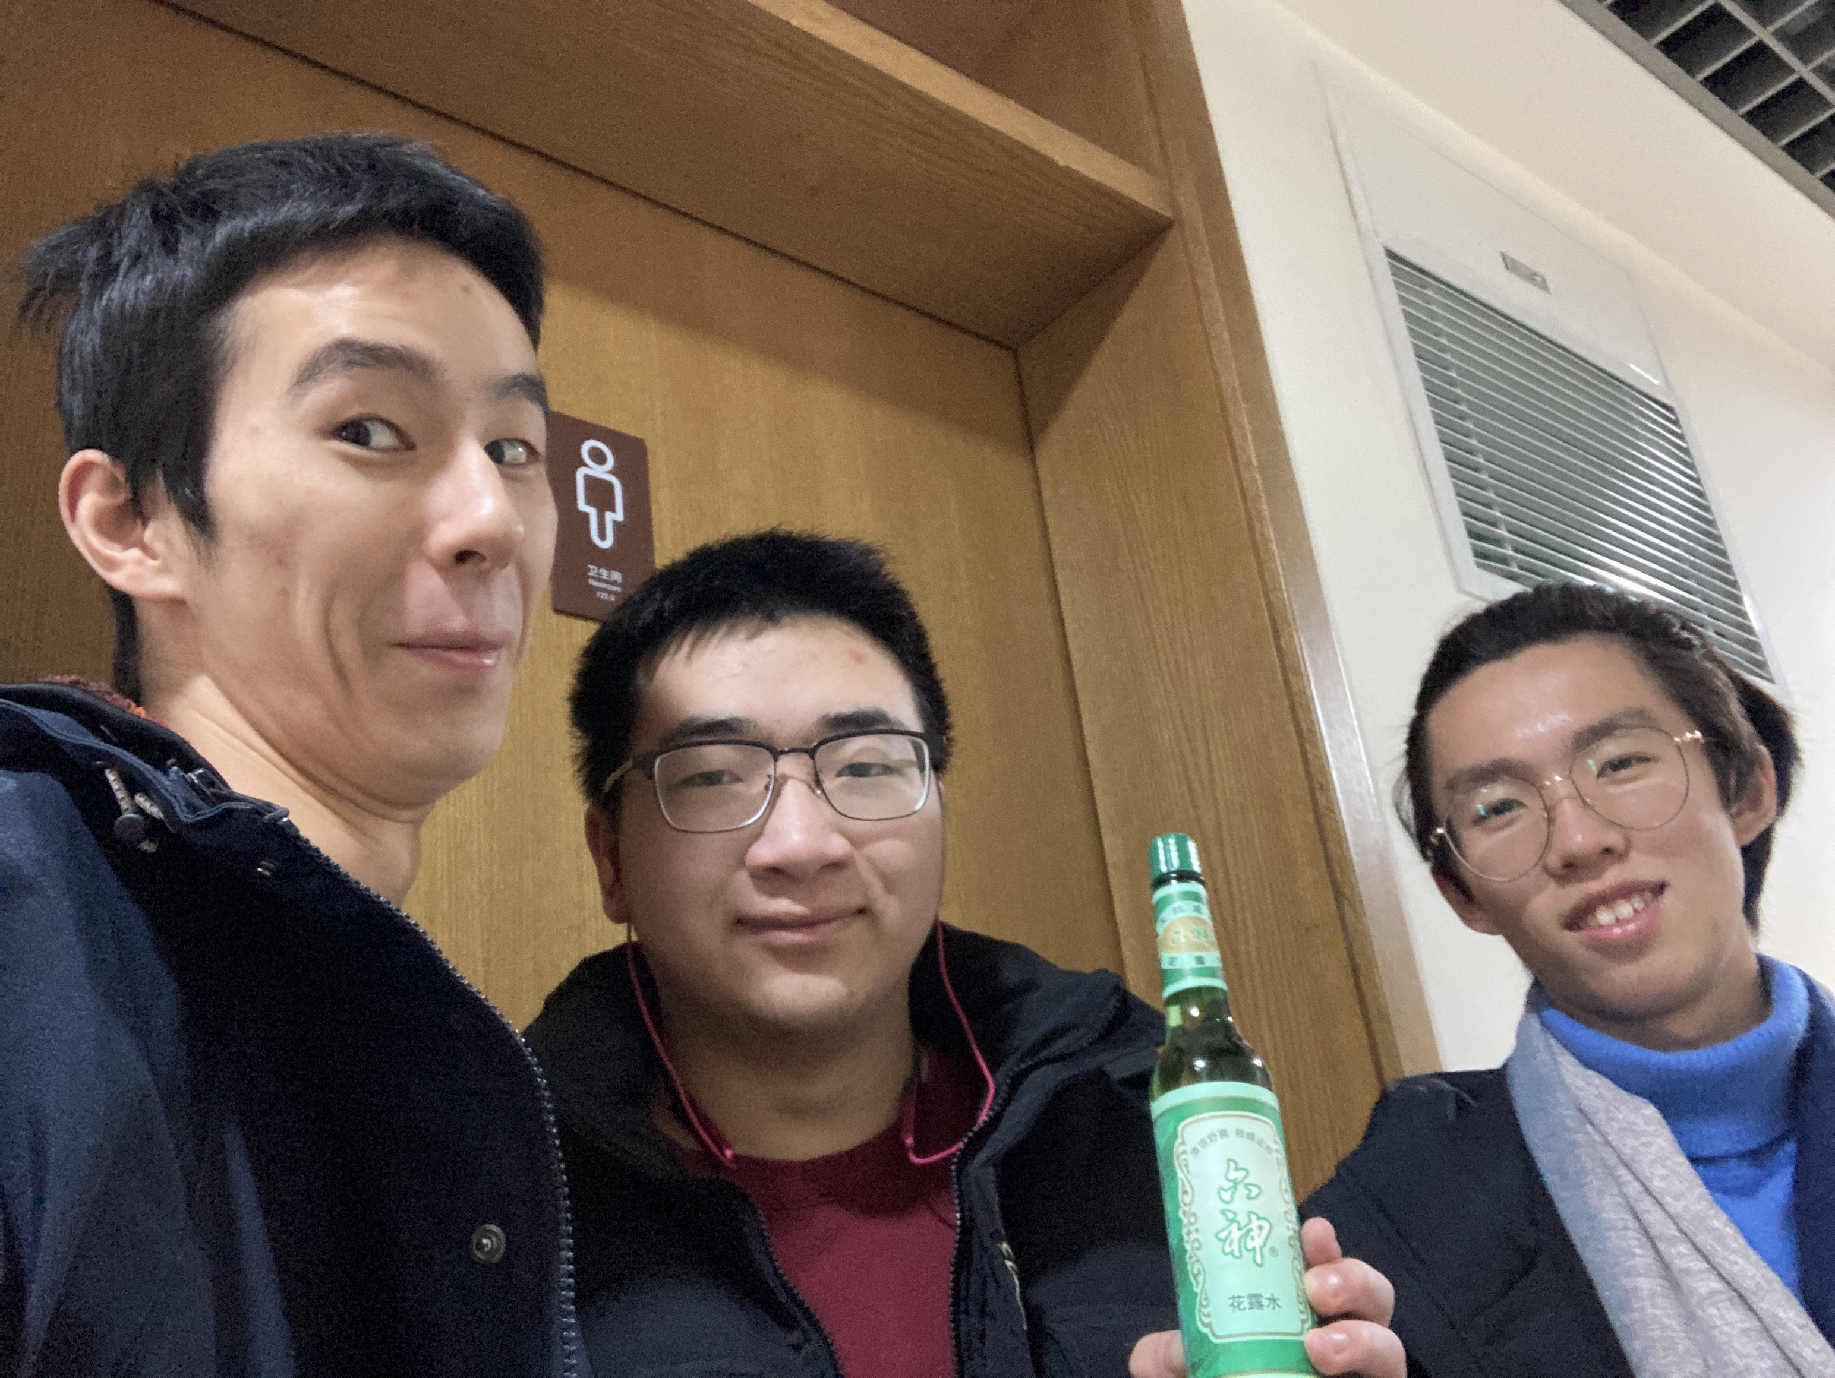

Sun tracking system —— 六神花露水
Overview 概述
Design 设计
‘Scorpio Sunflower’ （天蝎座太阳花）is a helioplant which can track light and output stable voltage.
By detecting the voltage difference caused by variation of Photosensitive resistance pair, it will rotate successively until difference shrinks to a threshold value so as to track light consecutively. Besides, it can restore to the default place when surroundings get dim.
What’s more, ‘Scorpio Sunflower’ owns the most attractive appearance and the most charming design with extremely austere style, elegant curve shape and highly integrated structure.
Besides basic function of light tracking, in order to realize stable and convenient control, several extended functions are designed to tackle special problems as follows:
Separated detection(分体检测)
Since the correspondence between left & right and east & west is not significant enough on the high latitude sphere, the judgment of horizontal direction is set to be independent from vertical one, so that the horizontal photosensitive resistance pair can move synchronously with the horizontal steering gear.
由于在高纬球面上，左右和东西的对应关系不再显著，我们将水平方向的判断独立出来，使水平光敏电阻对与水平舵机相同步运动。
Hemisphere transposition(半球转置)
Since the rotation threshold of the steering gear limits the full Angle rotation, the space is divided into two opposite hemispheres, so that the steering gear can transpose to the other hemisphere when the horizontal direction reaches the critical state.
由于舵机的转动阈值限制了全角度旋转，我们将空间分为正反半球，让舵机在水平方向达到临界状态时进行转置。
High-latitude restriction(高纬禁区)
No doubt that horizontal movement speeds up as latitude gets higher, resulting in the frequent disorder. Therefore, when in the high latitude, steering gear is prohibited from Hemisphere transposition.
由于纬度越高，纬线越短，水平方向的运动速度越大，导致舵机失控，我们禁止了舵机在高纬球面的俯仰越界和半球转置。
Team 团队
Yunyang Di
Project Management & Structure Assembly & Coding Implementation & 3-D Print Fabrication
Lehan Liu
Report writing & Optimized Circuit Design
Yuxuan Zhu
PCB Design & Voltage Stabilizing Circuit Design
Video 视频
Appearance & design 外观设计
Basic function 基本功能
Hemisphere transposition 半球转置
High-latitude restriction 高纬禁区

